Slide 1
W03D3 – Statistical Modeling
Instructor : Eithar Elbasheer
Slides Credit : Jeremy Eng

Slide 2
Outline
Statistical Modeling
Introduction
Statistical modeling vs machine learning
Regression vs Classification
Regression
Linear regression
Multivariate Linear Regression
Logistic Regression
Comparison to regression
Odds
Jupyter Demo
Run linear and logistic regression in python using the statsmodels package.
Interpreting output

Slide 3

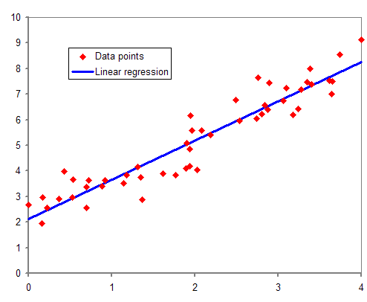
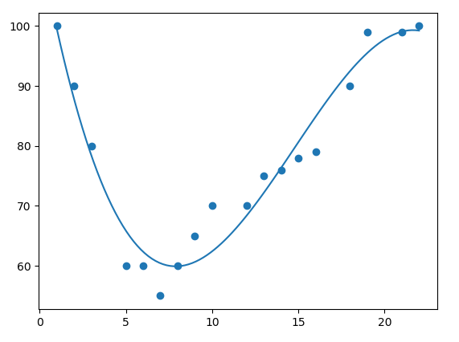
Statistical Modeling
Focused on determining the relationships between variables.
Interested in how well our data fits the modeled relationship
Can also make future predictions via “statistical inference”
E.g. Study on the relationship between weight gain vs caloric intake.

Slide 4
Statistical Modeling vs Machine Learning
Machine learning is focused on making predictions on new data.
Built on top of math and statistics.
Sometimes don’t care about interpretability
E.g. Predict weight gain from caloric intake.
Notes:
We will first just focus on statistical modeling. Later in the course we will focus on machine learning (focus on making predictions).

Slide 5
Regression and Classification
Two main types of statistical models (and ML models).
Regression models
Dependent (y) variable is continuous.
Determine the relationship between the dependent variable and one or more independent variables (x’s).
Involves finding a “best fit” line (or hyperplane).
Classification models
Dependent variable is categorical.
Determine the relationship between the dependent variable and one or more independent variables.
Usually involves finding the best decision boundary line (or hyperplane).

Slide 6
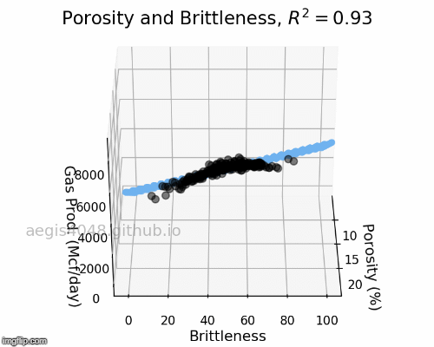
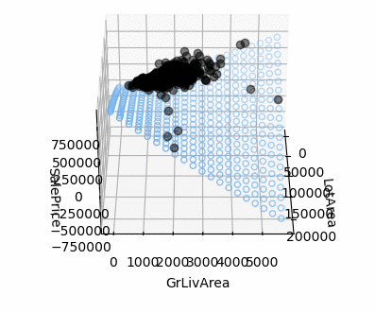
Regression Models
Linear Regression
Assumes a linear relationship between the dep variable and independent variable(s).
Tries to find the “best-fit” straight line (or hyperplane) through the data.
Simple (one indep.) or Multiple (more than one indep.) linear regression.
Polynomial Regression
Tries to find the best polynomial (curved) line (or manifold) through the data.
Extension of linear regression
Can also have one or more indep. variables.
Notes:
Linear relationship: When the indep variable goes up by 1 unit, the dep variable goes up by a constant amount (e.g. hours worked and pay) (non-linear ex: years worked and pay).
Polynomial: When a line doesn’t fit the data nicely
Won’t cover polynomial regression yet. Later.

Slide 7
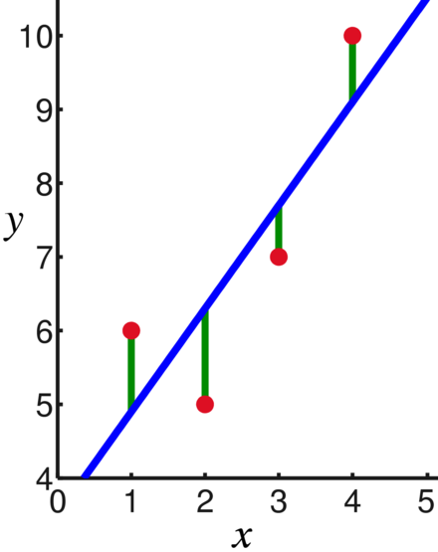
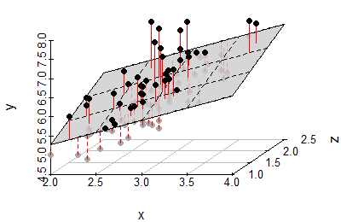
Linear Regression
How do we determine this “best fit” line (or hyperplane).
Most common method is called “Ordinary Least Squares” (OLS)
Minimize the sum of the squared vertical distances between observed data and the best-fit line.
This difference between the observed data and the line is called a “residual”.
Mathematically:
Line: y = mx+b
Residual sum of squares: Σ(y_{i} – (mx_{i}+b))²
Use calculus (minimization) to determine m and b.
For multivariate linear regression:
y = b₀ + b₁x₁ + b₂x₂ + … + b_{m}x_{m} (equation of hyperplane)
Use calculus to determine b₀, b₁, b₂, …, b_{m}
These coefficients (slopes) tell us how y changes when each x_{i} changes.
Notes:
Just focus on the simple linear regression case for now.

Slide 8
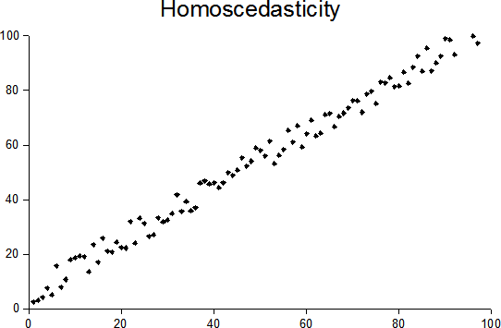
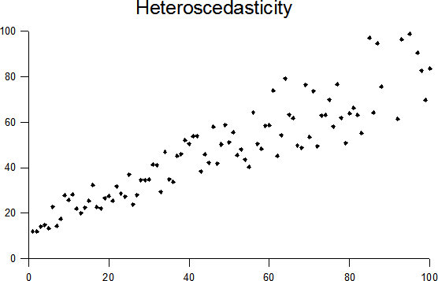
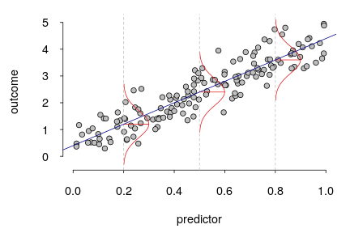
Linear Regression Assumptions
For simple linear regression:
The relationship between the variables is a straight line or hyperplane (linearity).
Each data point is independent of the others (independence).
The errors are normally distributed (normality).
The size of the errors is the same no matter where you are on the graph (homoscedasticity).
The variables don't affect each other too much (no multicollinearity).
Notes:
In practice, most of these can be assumptions can be checked by examining the “residuals” (more details on what these and how to do this later)
Prior to residuals, we can informally look at:
Linearity
Scatter plot, correlation with dep. variable, Pearson’s correlation test
Independence
Based on how the data was collected (experiment design).
Homoscedasticity
Scatterplot
Normality
Can be tested afterwards by looking at residuals (will see in demo).
Multicollinearity
Correlation test on indep variables (informally with correlation matrix).

Slide 9
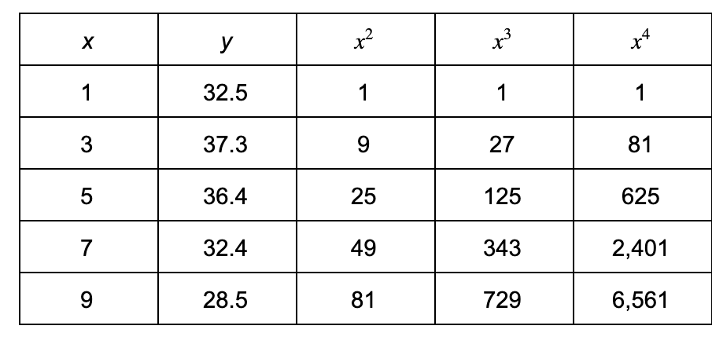
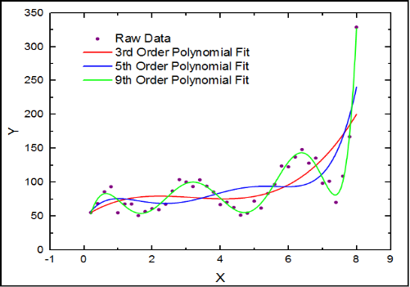
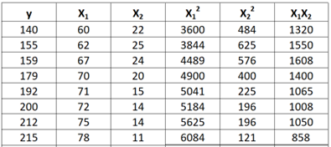
Polynomial Regression
If we want to perform polynomial regression, we just create more data by squaring, cubing, etc. our original independent variable.
Then apply linear regression
y = b₀ + b₁x + b₂x² + b₃x³ +… + b_{d}x^{d}
Then just apply linear regression (OLS).
The residual sum of squares will be minimized to get the best-fit polynomial.
Similar process can be done for Multiple Polynomial Regression.
Notes:
Note multicollinearity problem

Slide 10
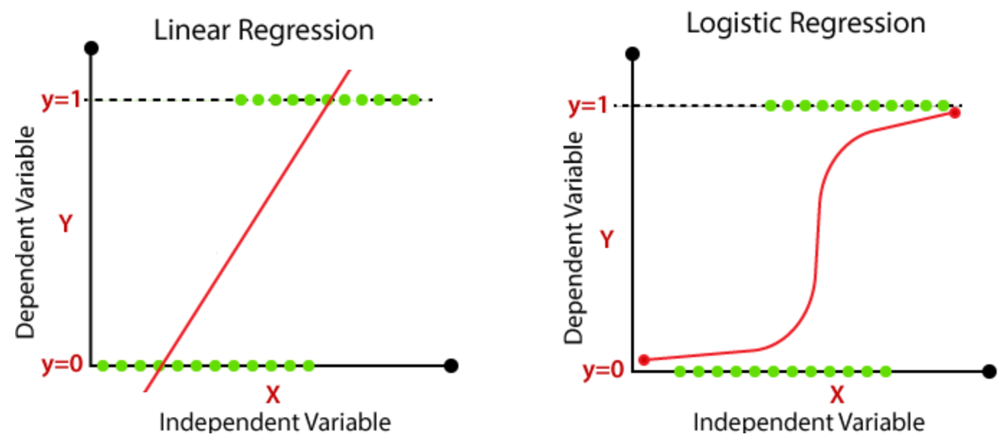
Logistic Regression
What if the dependent variable is a category instead of a continuous value?
Linear regression does not seem to be a very good model!
Notes:
y (dep) = test result (pass/fail)
x (indep) = hours studied
Logistic regression line can be interpreted as “probability of category 1”.

Slide 11
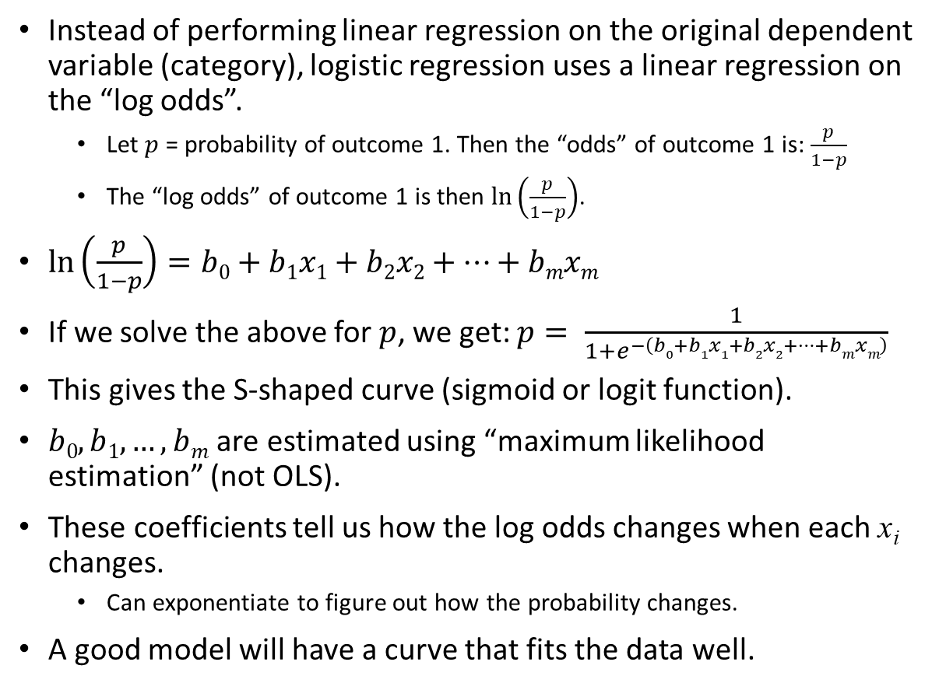
Logistic Regression
Notes:
y (dep) = test result (pass/fail)
x (indep) = hours studied

Slide 12
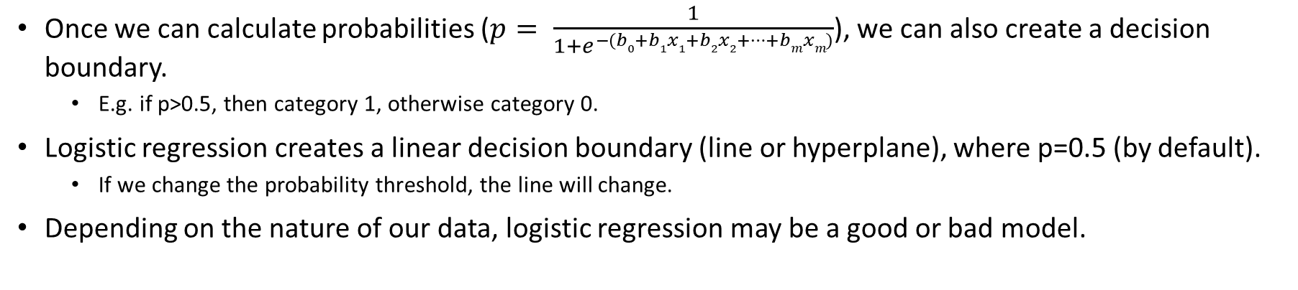
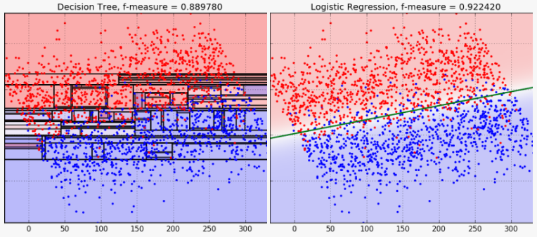
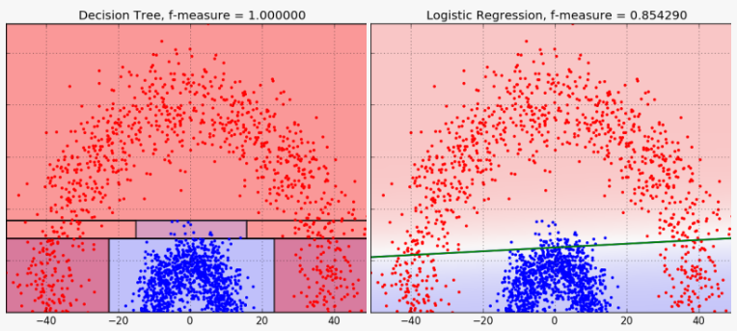
Logistic Regression – Decision Boundary
Notes:
Briefly mention how there is also multi-class classification (one vs all)

Slide 13
Jupyter Notebook Demo
We will:
Perform linear and logistic regression in python using the statsmodels package.
Interpret the output.

